Slide 1
journey into academics

Slide 2
Dive into my story
https://youtu.be/vouHTZ_g7zg

Slide 3
Topics to note
introduction
Exploring Campus culture
Program of study
Favorite subject
History of the premier university
Experience in the university of ghana
Choice of institution
State of accommodation
Course in details

Slide 4
introduction
Brief of overview of the bachelor of science in informative technology program.
Explanation of the decision to pursue this course.
Importance of technology in today’s rapidly evolving world.

Slide 5
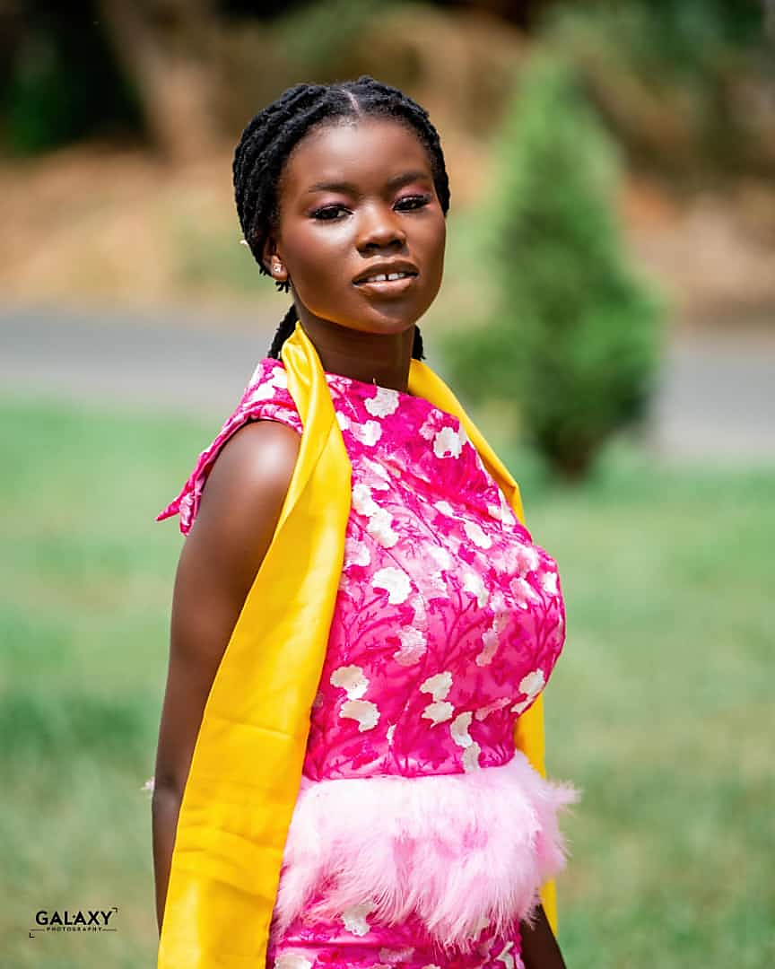
My journey at the university of ghana
Introduction
Initial impressions: Positive and negative aspect about the university of Ghana.
CAMPUS ENVIRONMENT: amazement with the architecture and student dress code.
Finding my way
Navigating campus: Difficulties finding the computer science department.
SEEKING GUIDANCE: Seeking advice from senior students.
SETTLING IN: Adjusting to campus culture and academic expectation.
ACCOMMODATION HURDLES
LATE REALISATION: Confusion over bed allocation.
Notes:
Off-Campus Living: Deciding to find accommodation off-campus.
Challenges: Dealing with the rush before lectures begin.
Academic Beginnings
First Lectures: Initial experiences with DCIT101 and DCIT105.
Realizations: Reflecting on course selection and academic challenges.
Diligence: Focusing on assignments and lectures to excel academically.
Social Adaptation
Personal Challenges: Struggles with socializing due to personality traits.
Building Connections: Forming friendships and expanding social circle.
Memorable Moments: Celebrating milestones like matriculation day with friends.
Lessons Learned
Personal Growth: Learning from experiences and interactions.
Beauty of Success: Understanding the importance of diligence and academic success.
Looking Ahead: Excited for the journey ahead and embracing future challenges.
Acknowledgment
Gratitude: Thanking supporters, mentors, and friends for their role in the journey.
Promise: Commitment to make the most of the opportunities and support received.

Slide 6



Program of study
Subtitle: Bachelor of science in information technology.
Presenter: kuewu Pamela .
Date: 2nd April, 2024

Slide 7
Reasons for choosing information technology
Factor influencing the decision to study information technology.
Importance of staying relevant in a changing technological landscape.
Motivation from family and the desire to innovate for their benefit.

Slide 8

Favorite subject
office productivity tool
Introduction to the office productivity tools course.
Reasons for interest, including its professional relevance and potential for income.
Mention of other challenging yet intriguing course in computer science and mathematics for I.T professional.

Slide 9
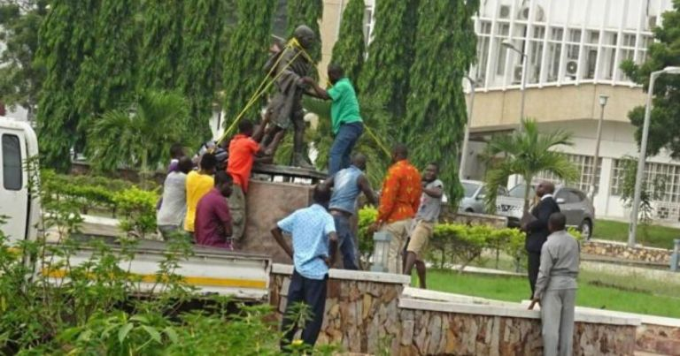


History of the university of ghana
Overview of the founding and evolution of
The university of Ghana.
Brief description of its current structure and
Student population.
Importance of the university’s establishment in
The context of higher education in west African

Slide 10
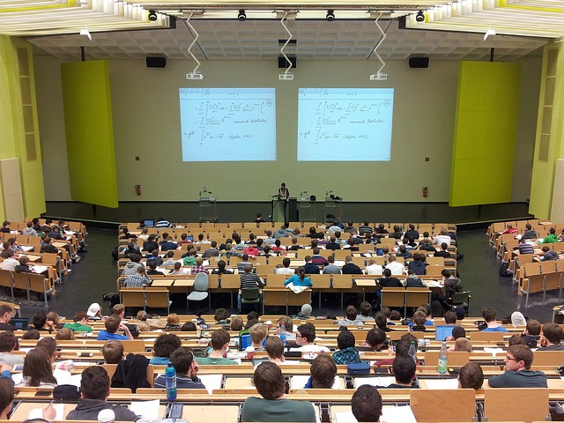

Experience at the university of ghana
Personal reflection on the initial experience
At the university.
Adaptation to campus life and involvement in academic and social activities.
Lessons learned and growth experience through challenges and interactions.

Slide 11

Choice of institution
Process of selecting the university of ghana for academic reputation, opportunities, and scholarship offerings.
Importance of finding a university that aligns with personal values and aspirations.

Slide 12


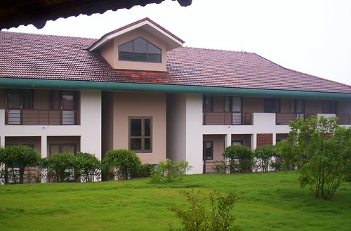
State of accommodation
Discussion on living off-campus due to random allocation.
Advantages and challenges of off-campus living, including independence and commuting.
Reflection on the experience as an opportunity for personal growth.

Slide 13
Course in detail
Detailed overview of office productivity tool course.
Discussion on its benefits, including enhancing creating and logical thinking.
Insight into assessment methods and the instructor’s approach to teaching.

Slide 14
Chapters continued
Continued with chapter 3 to chapter 8 content on separate slides

Slide 15
conclusion
Summary of key points discussed throughout the presentation.
Reiteration of enthusiasm for studying information technology at the university of ghana.
Invitation for questions and discussions from the audience.

